Slide 1





Class Instruction
Teacher
Four-role System
Teacher Assistant
T: design, lead, host, help
TA: Help T to give examples and guide GL.
GL: Help TA and guide GM.
GM: Work together and help each other.
Group Leader
Group Member

Slide 2

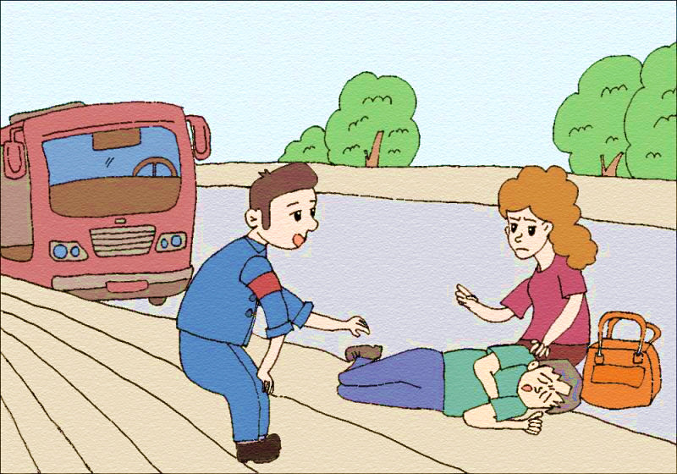

Unit 1 What’s the matter?
Section A Reading
于海洋

Slide 3
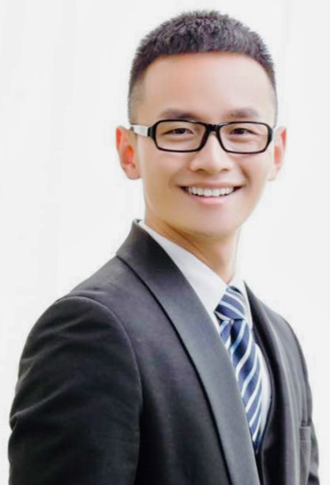
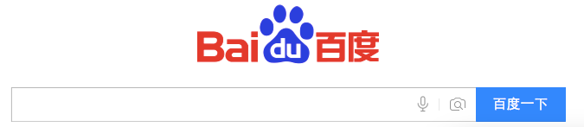


Before Reading
Yu Haiyang
Chongqing No.1 Middle School
于海洋 重庆一中
Notes:
背景 before reading

Slide 4
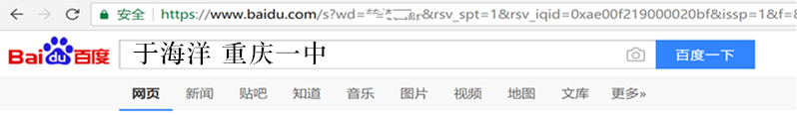

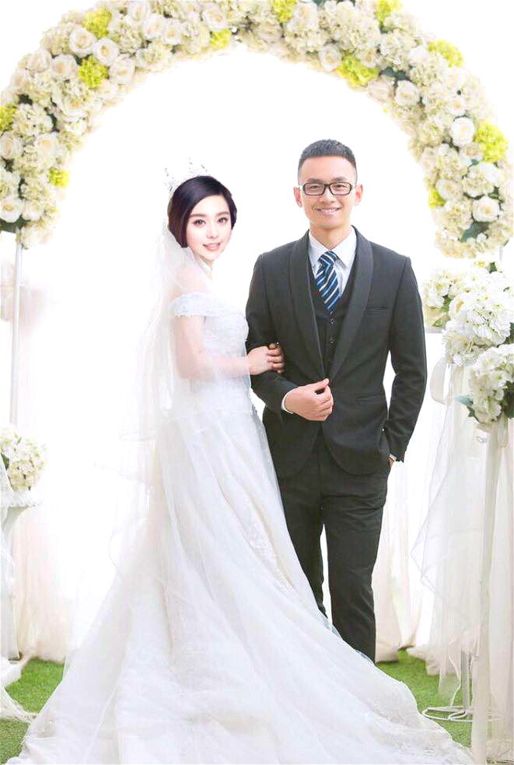
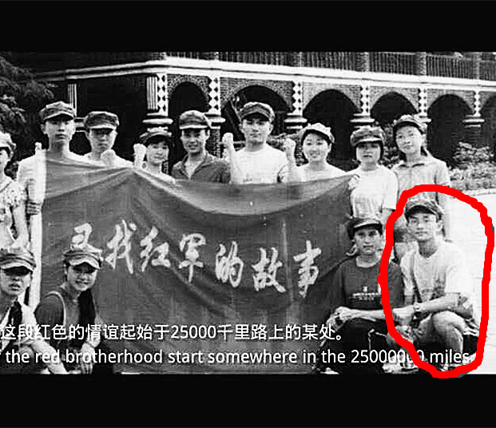

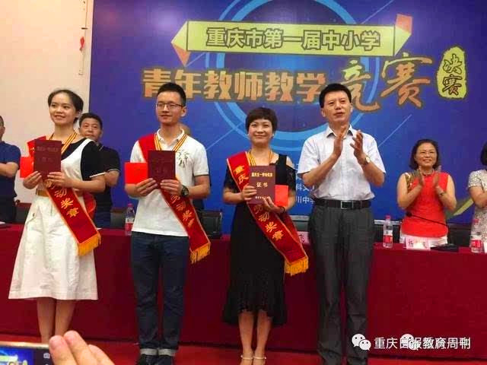

What should news be like?
1. Mr. Yu marries Fan Bingbing
in time
in story
New
True
2. Mr. Yu acted in a movie 20 years ago
3. Mr. Yu wins a teaching competition
Notes:
引出新闻的特征，设置锦囊增添悬念，分四个小组，方便接下来的小组竞赛和讨论 “ Just now you told me it’s a piece of news, but why?” “ Look at the time, did it happen a long time ago? No, it’s just yesterday, so it’s new in time” “ and look at the title and story, did I make it up? Is it true? Yes, so it’s true in story” “So, from above we can see it’s a piece of news. But do you know how to read and write a piece of news? Don’t worry the secret is in the tip bag…Now we have 4 groups, the group with the highest point can have the change to open the tip bag, so try your best!”

Slide 5

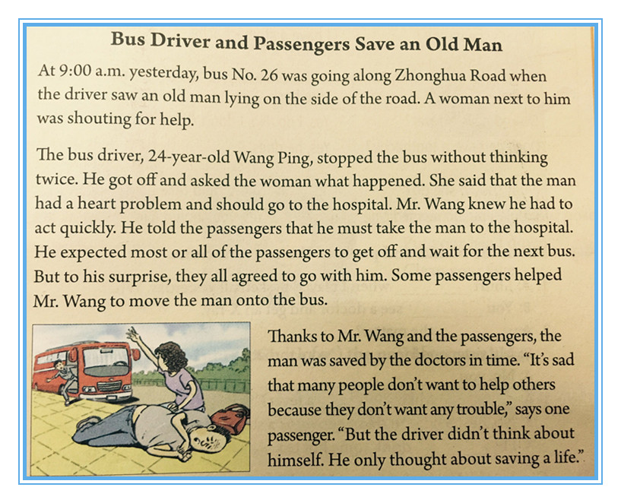
the eye of news
New in time
True in story
Notes:
引出新闻的特征，设置锦囊增添悬念，分四个小组，方便接下来的小组竞赛和讨论 “ Just now you told me it’s a piece of news, but why?” “ Look at the time, did it happen a long time ago? No, it’s just yesterday, so it’s new in time” “ and look at the title and story, did I make it up? Is it true? Yes, so it’s true in story” “So, from above we can see it’s a piece of news. But do you know how to read and write a piece of news? Don’t worry the secret is in the tip bag…Now we have 4 groups, the group with the highest point can have the change to open the tip bag, so try your best!”

Slide 6
Fast Reading
Match the main idea
Para.1
A. How people saved the old man
Para.2
B. What was the result of the story
Para.3
C. What the bus driver saw

Slide 7

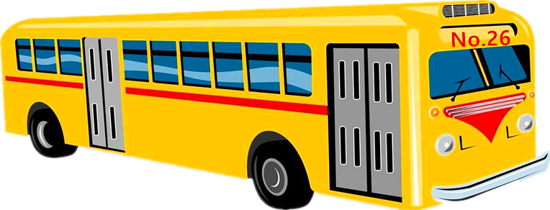
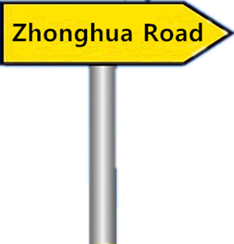
Careful Reading
Para.1
when
At 9:00 a.m. yesterday, bus No.26 was going along Zhonghua Road when the driver saw an old man lying on the side of the road. A woman next to him was shouting for help.
when
where
who
what
…
lead（导语） :
important information

Slide 8
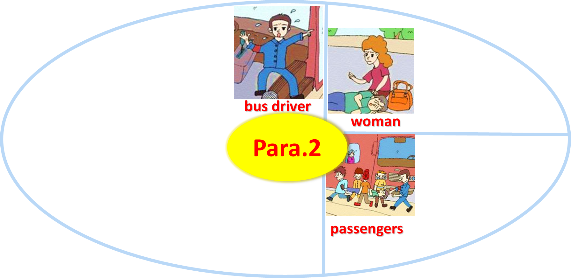
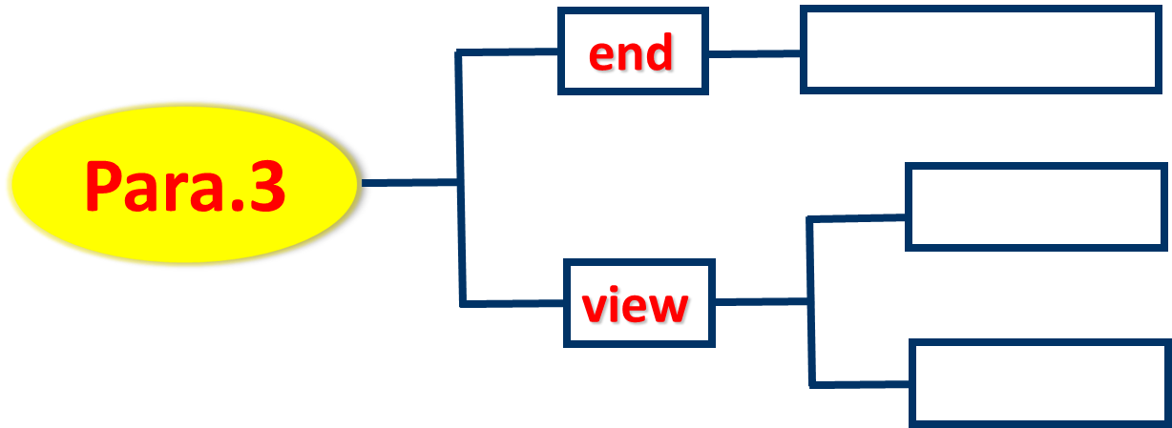
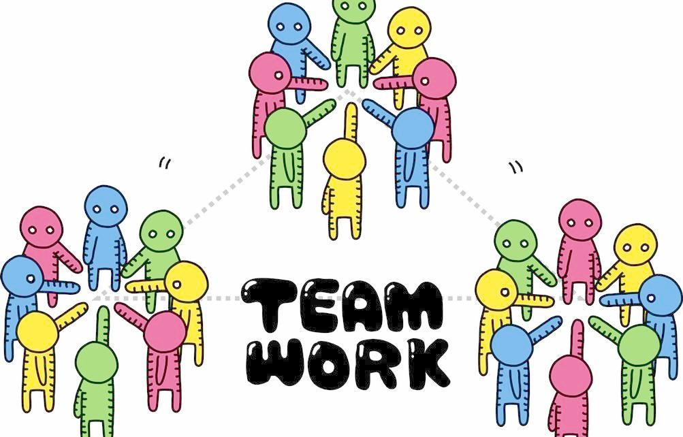
Careful Reading
Para. 2&3
How people helped the old man
What was the result of the story
T: design, lead, host, help
TA :Help T to give examples and guide GL.
GL: Help and guide GM.
GM: Work together and help each other.
Tip: key words

Slide 9

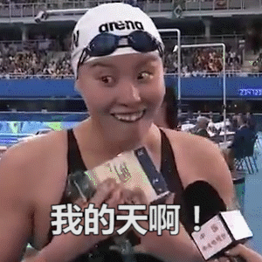
Further Reading
Para. 2
What do you think of the news language?
simple and lively
The bus driver, 24-year-old Wang Ping, stopped the bus without thinking twice. He got off and asked the woman what happened. she said that the man had a heart problem and should go to the hospital. Mr. Wang knew he had to act quickly. He told the passengers that he must take the man to the hospital. He expected most or all of the passengers to get off and wait for the next bus. But to his surprise, they all agreed to go with him. Some passengers helped Mr. Wang to move the man onto the bus.

Slide 10

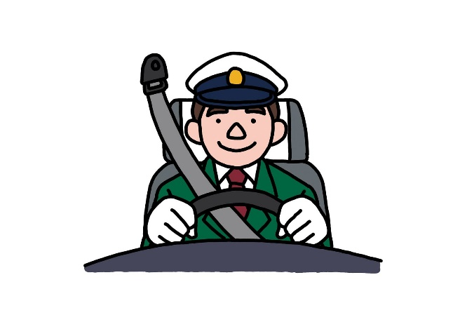




Further Reading
Para. 3
I think…
…great
I love…
…so much!
Thanks to…
…in time
But…
…only…
…don’t want trouble…
…saving a life…
Which words show the writer’s view?
Which side is the writer on?
news view: clear and calm
Thanks to Mr. Wang and the passengers, the doctors saved the man in time. “It’s said that many people don’t want to help others because they don’t want any trouble,” says one passenger. “But the driver didn’t think about himself. He only thought about saving a life.”

Slide 11
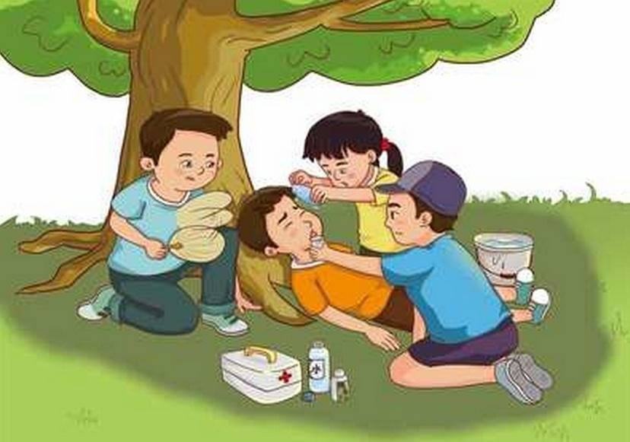
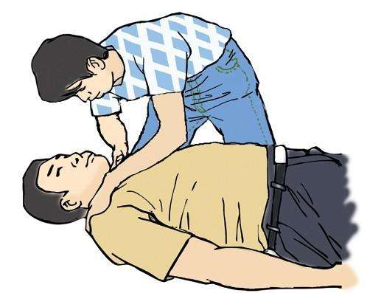
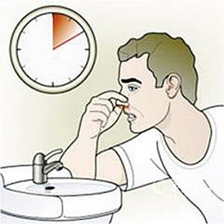
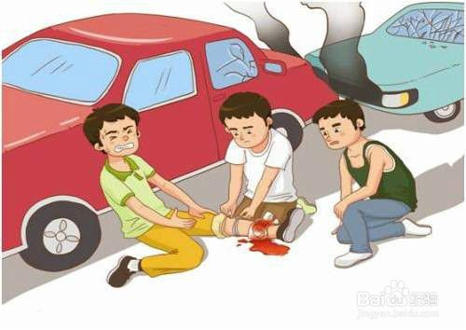

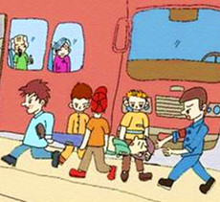
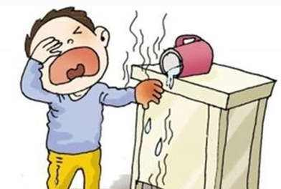
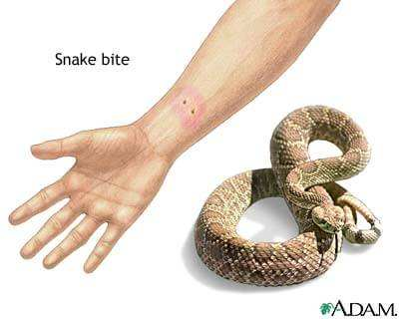
Discussion
https://www.verywell.com
Do you agree with the writer? Why or why not?
shout for help
take… to hospital
move
Notes:
Look at the title and picture. “How many people can you see?” “ What was the woman doing?”

Slide 12
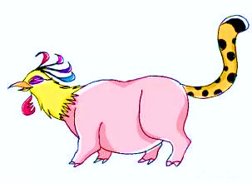








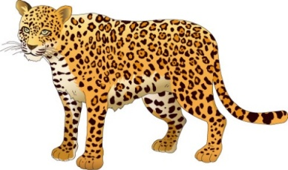

Overall Reading
“Phipard”
phoenix + pig + leopard
beginning
development
end (view)
phoenix（凤）
when
pig（猪）
development
end
(view)
where
beginning
who
eye-catching
simple and lively
clear and calm
what
leopard（豹）
Notes:
揭晓锦囊内容 引出本篇新闻结构 Now， it’s time to open our tip bag…

Slide 13
Writing
Write a piece of news with the “Phipard Structure”
A New Teacher Gives an Interesting Class
?
?
Sweet Tips:
Two for the head.
Two for the body.
Two for the tail.
Then report together.

Slide 14
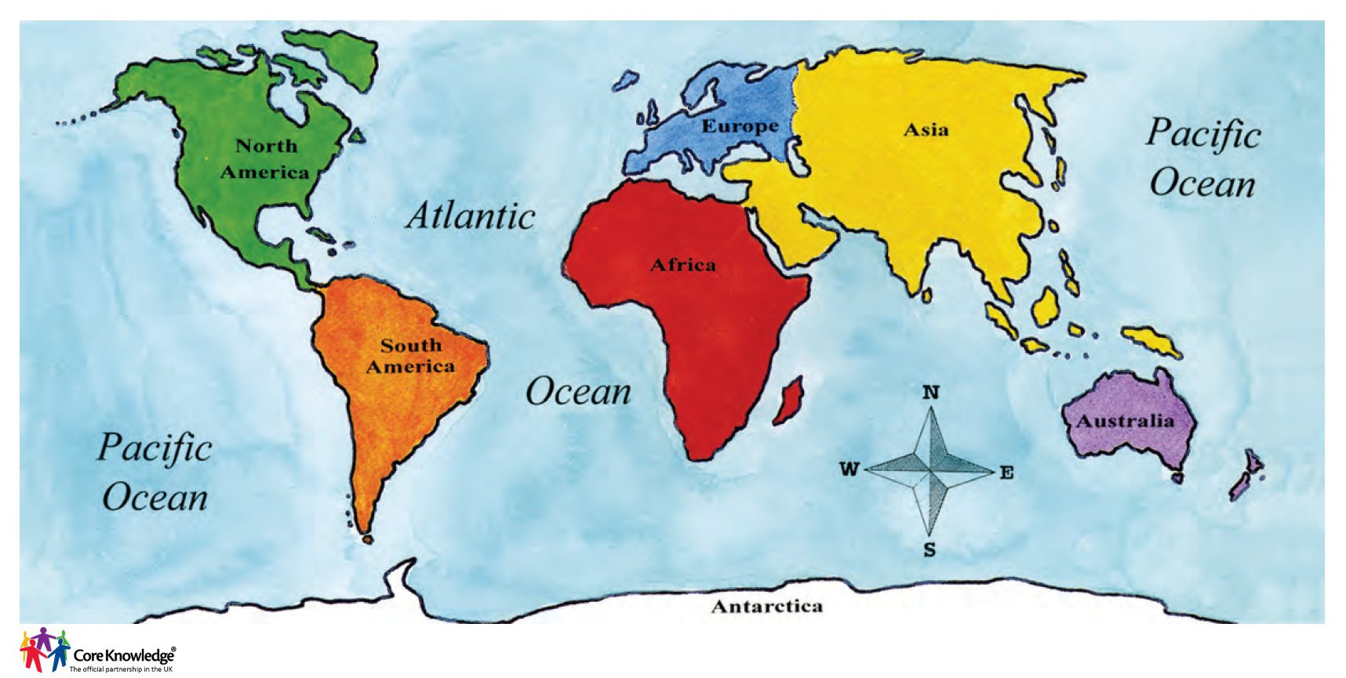

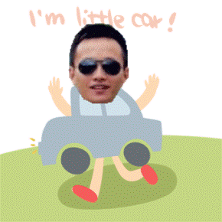
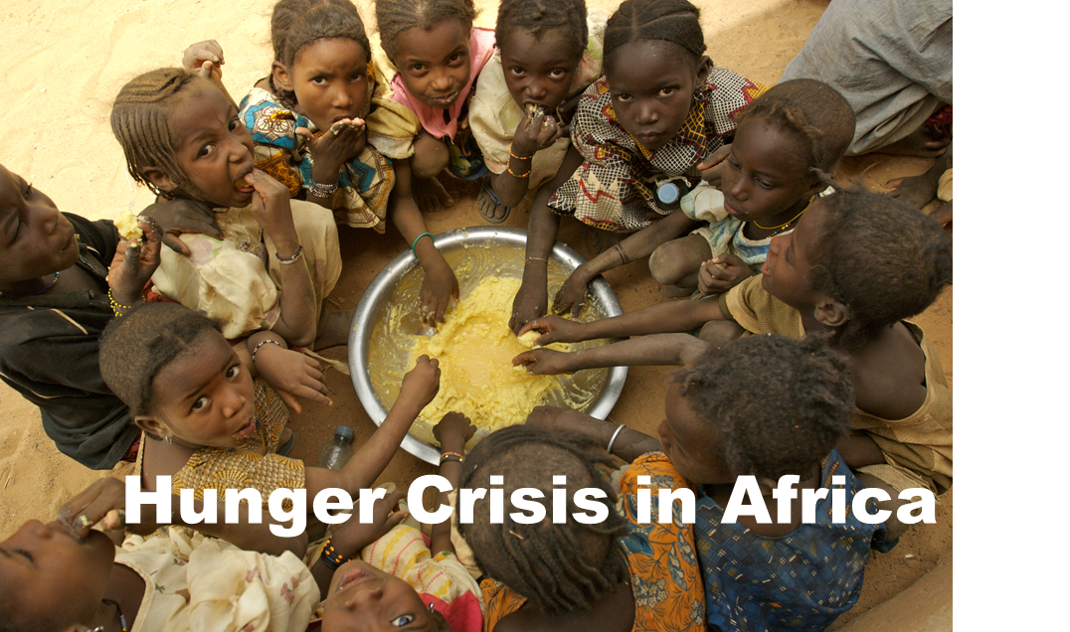


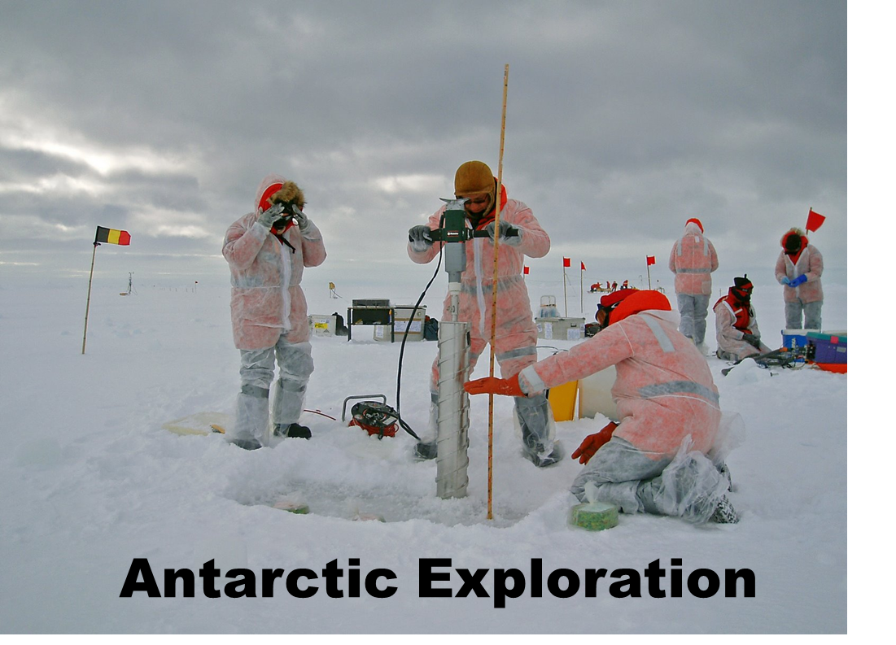
North
West
Zhenjiang
East
South

Slide 15



Homework
1. Learn more about first aid and share it in the next class.
2. Finish the news and learn to report it from BBC or CNN.

Slide 16


